Slide 1
Social Emotion Classification using Hybrid Neural Networks
PRESENTED BY
L . Anmisha Reddy 14251A0586
R . Snigdha 14251A05A5
S . Aashrita 14251A05B0
Sri Poojitha Mandali 14251A05B1
INTERNAL GUIDE
Mrs.T.Swapna
Asst.Professor

Slide 2
CONTENTS
INTRODUCTION
FLOW OF PROJECT
DATA SETS
ADVANTAGES
SYSTEM REQUIREMENTS
CONCLUSION

Slide 3
INTRODUCTION:
Involve social emotion classification which aggregates the emotion response contributed by various users in comments or tweets.
Semantically rich recurrent neural networks are used to enhance social emotion classification and interpretability.
Classified into 13 class labels.

Slide 4
Flow of Project:
Deep learning(building neural network) + supervised learning models=social emotion
Classification:
It takes the document features first and it does the data cleaning and data analysis then secondly, supervised learning model are used for feature transformation in neural network building.
The neural networks help to improve the accuracy. In case of our project it improved our accuracy from 61.9% to 92%.

Slide 5
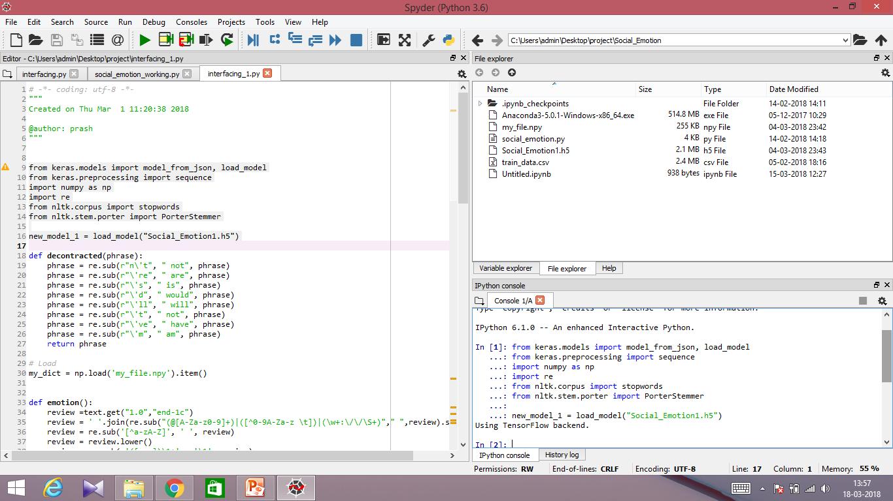
Used the Spyder platform which is an open source cross-platform integrated development environment (IDE) for scientific programming in the Python language. Spyder integrates NumPy, SciPy, Matplotlib as well as other open source software.
It has:
1.Program space
2.Console (for execution)
3. File explorer and variable explorer

Slide 6
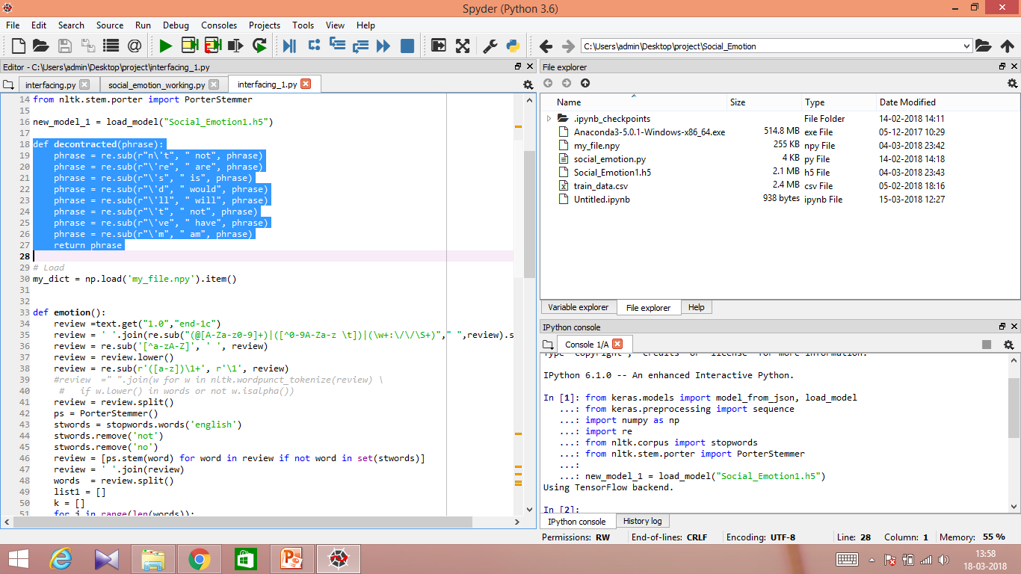
Here libraries such as numpy and pandas are imported to support large set of arrays and matrices & for data analysis and manipulation on numeric tables and time series. The below highlighted code converts the short cut words to meaningful form.Eg: for isn’t is converted to is not and we’ll is converted to we will.

Slide 7
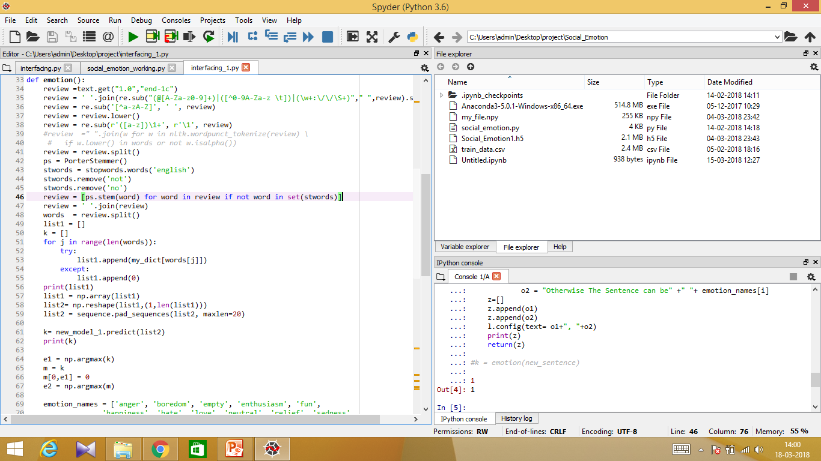
The beside code describes the data cleaning and data preprocessing of the given input by user as well as for the training dat to test against test data.
It removes the uncessary words in a sentence and removes tagging words and hastags.
It creates a corpus of words with only meaningful words in sentence.

Slide 8
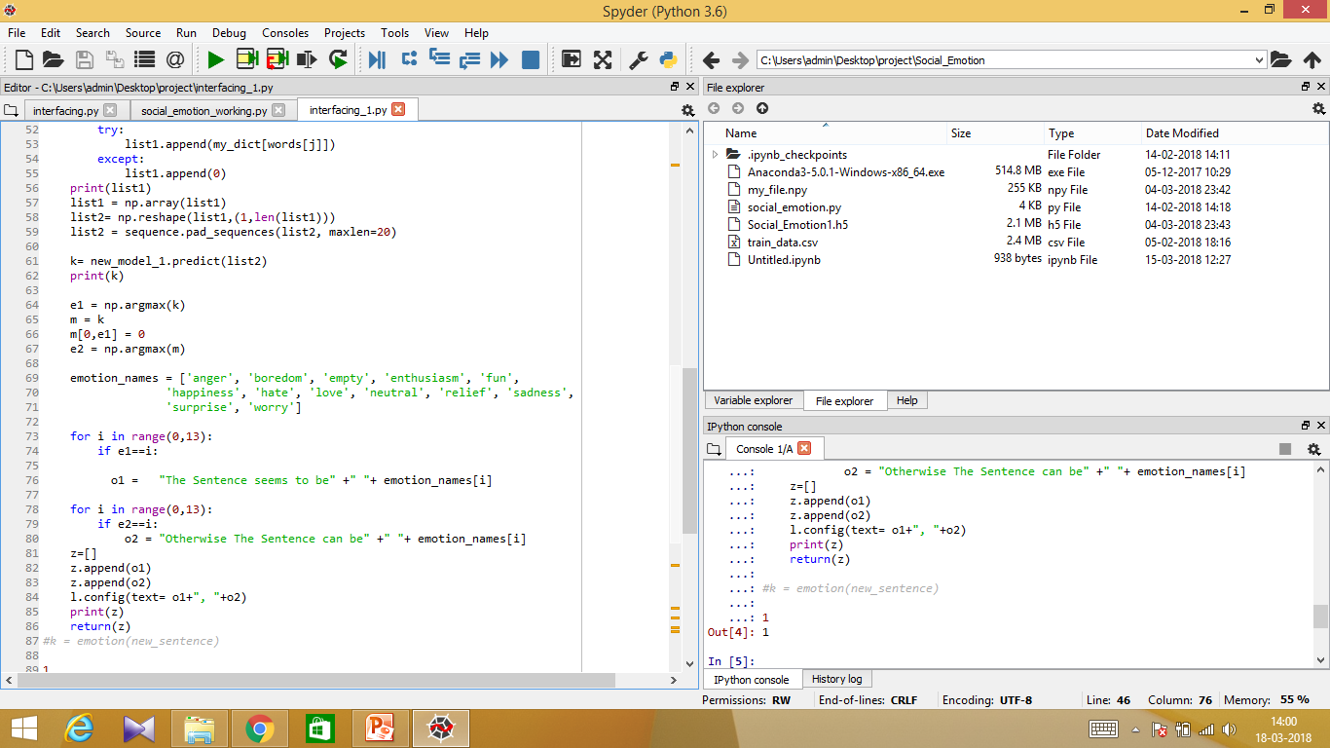
NLTK(natural language tool kit is used to recognise our text and symbols. We used the concept of word to vector with count vectorizer which creates a bag of words related to a class label.

Slide 9
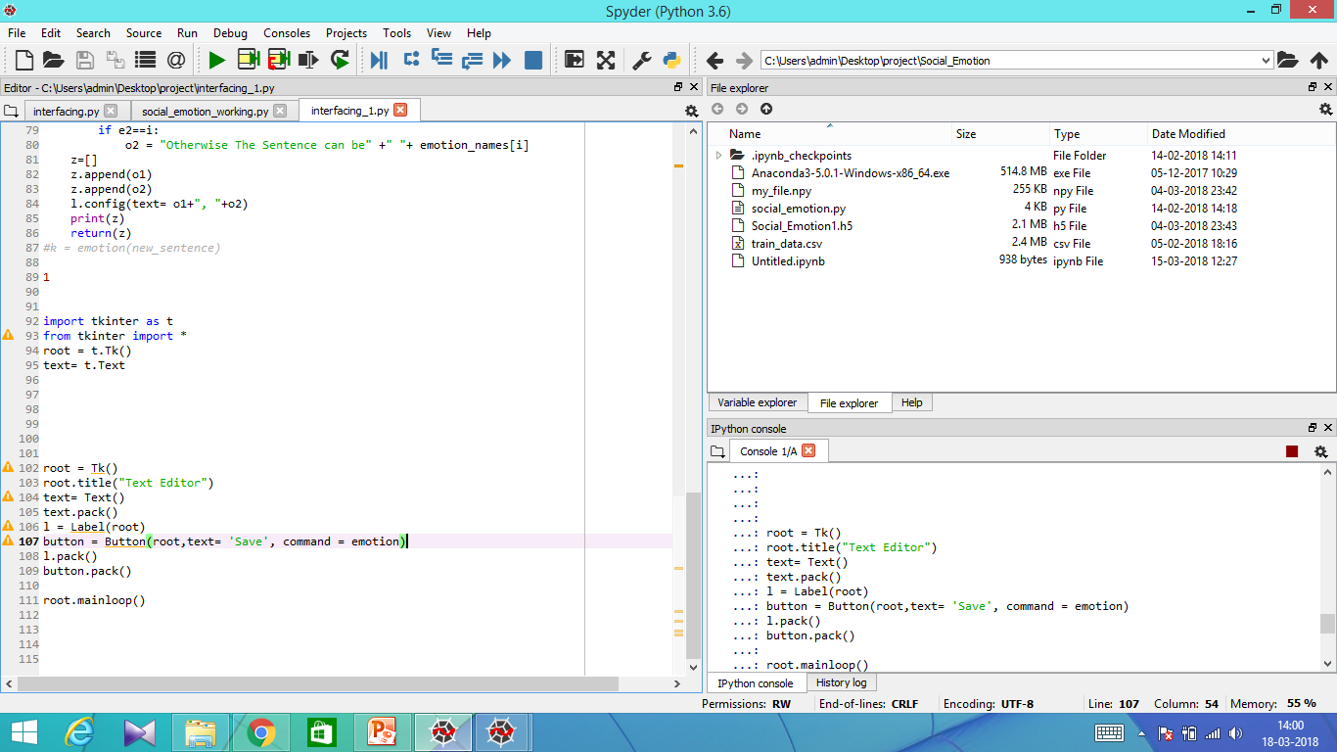
Count vectorizer concept allows random numbers to be assigned to those bag of words which in turn creates a dictionary (where word is key and no is value) of important words from the dataset.
Keras is the neural network library used in our project to support various functions and API’s for the building of recurrent neural networks which runs on the top of tensorflow backend.

Slide 10
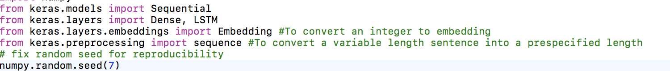
Building the neural network
Initially , we require Keras and a backend (Theano or TensorFlow) installed and configured.
Once that is set up, a model can be built as follows
1.Load Data : We can initialize the random number generator with any seed you like, for example:

Slide 11
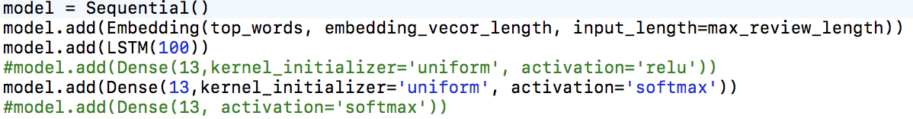
2.Define Model : Models in Keras are defined as a sequence of layers.
Fully connected layers are defined using the Dense class. We can specify the number of neurons in the layer as the first argument, the initialization method as the second argument as init and specify the activation function using the activation argument.
In this case, we initialize the network weights to a small random number generated from a uniform distribution (‘uniform‘), in this case between 0 and 0.05 because that is the default uniform weight initialization in Keras.
We will use the rectifier (‘relu‘) activation function on the first two layers and the sigmoid function in the output layer.

Slide 12
3.Compile Model : Compiling the model uses the efficient numerical libraries (backend) such as Theano or TensorFlow. The backend automatically chooses the best way to represent the network for training and making predictions to run on your hardware.
We must specify the loss function to use to evaluate a set of weights, the optimizer used to search through different weights for the network and any optional metrics we would like to collect and report during training.
In this case, we will use logarithmic loss, which for a binary classification problem is defined in Keras as “binary_crossentropy“. We will also use the efficient gradient descent algorithm “adam”“.
Finally, because it is a classification problem, we will collect and report the classification accuracy as the metric.

Slide 13
4.Fit Model
Now we execute the model on some data.
We can train or fit our model on our loaded data by calling the fit() function on the model.
The training process will run for a fixed number of iterations through the dataset called epochs, that we must specify using the nepochs argument. We can also set the number of instances that are evaluated before a weight update in the network is performed, called the batch size and set using the batch_size argument.

Slide 14
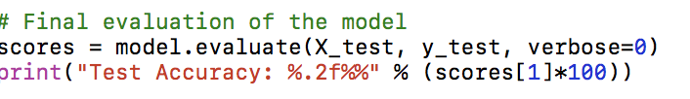
5.Evaluate Model: We have trained our neural network on the entire dataset and we can evaluate the performance of the network on the same dataset
This can be done using evaluate() function on your model to train it.
This will generate a prediction for each input and output pair and collect scores, including the average loss and any metrics you have configured, such as accuracy.

Slide 15
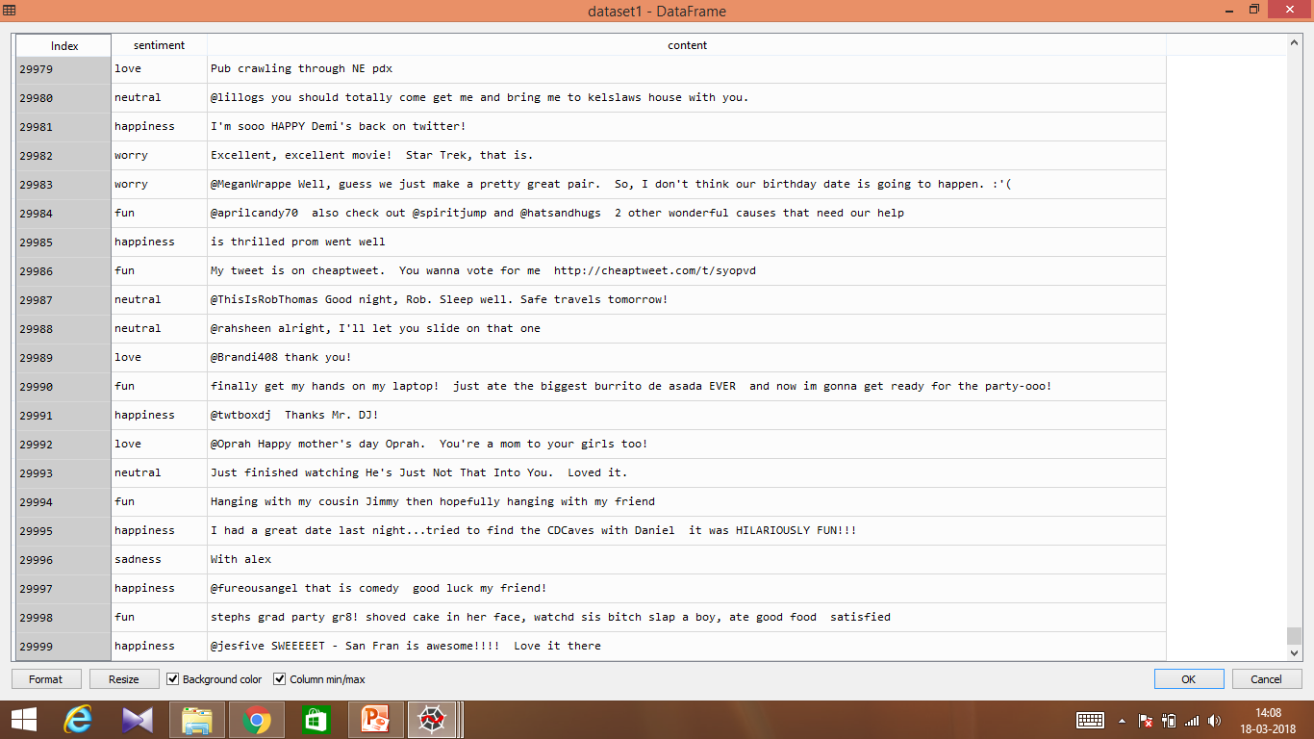
Data sets
To evaluate the effectiveness of proposed RNN’S for social emotion classification ,we employed short message(semEval and ISEAR). Our dataset consists of 30000 textual sentences with 13 different class labels.

Slide 16
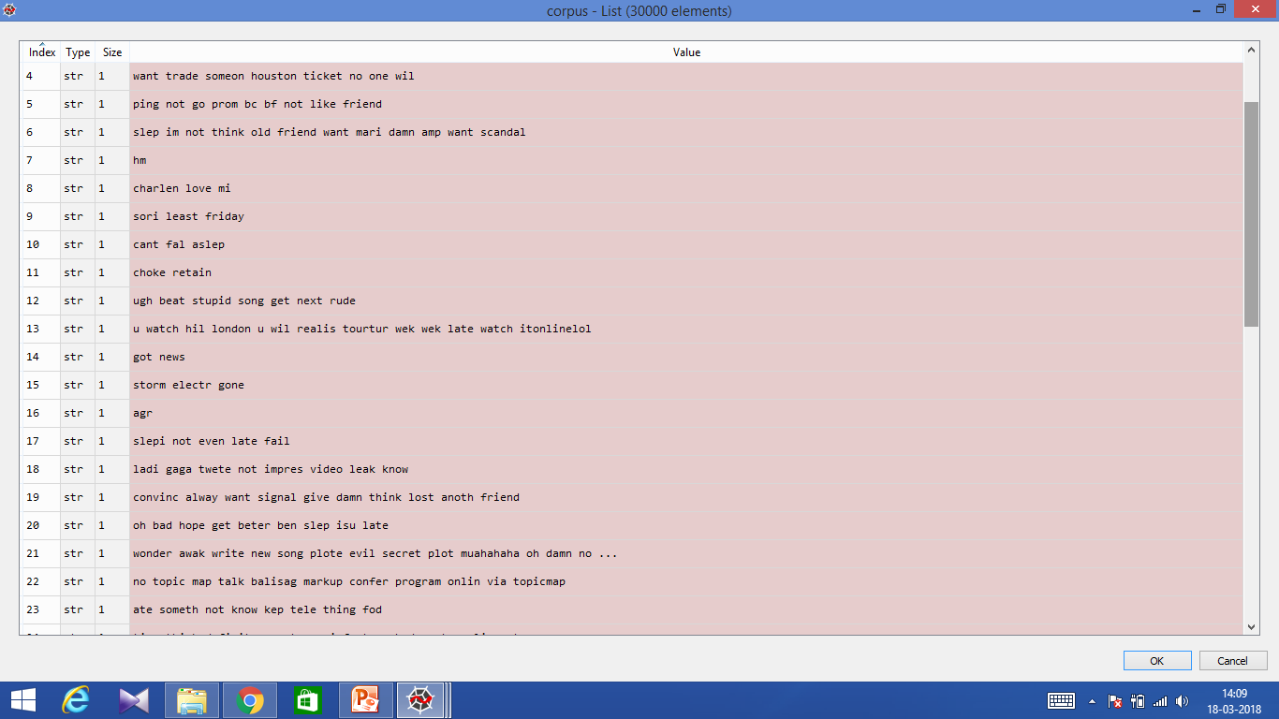
Corpus dataset used for the lexical analysis as a word to text tokenizer

Slide 17
We used both TENSORFLOW and THEANO software library as the backend interface for dataflow programming across range of tasks in our project.

Slide 18
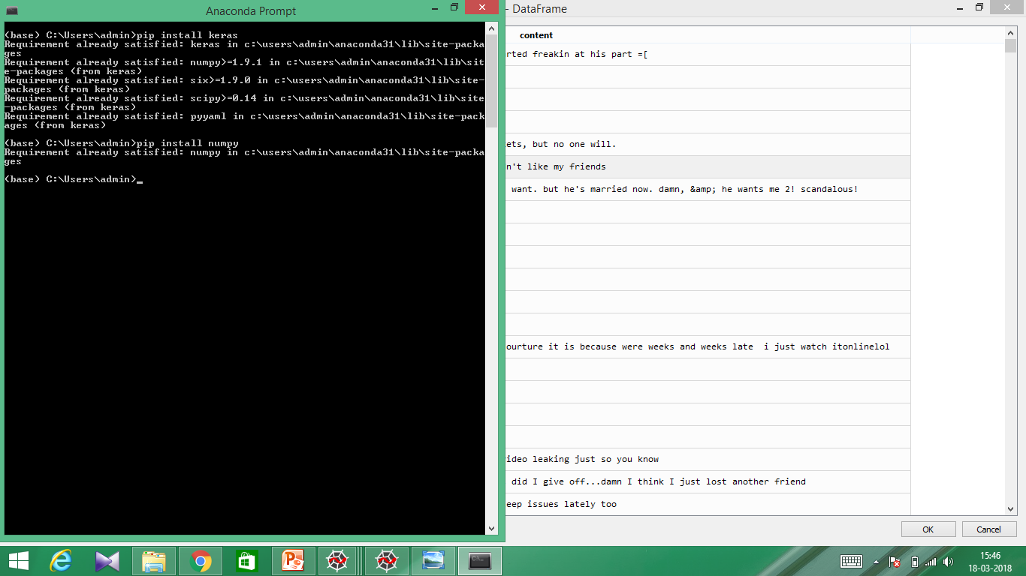

Slide 19
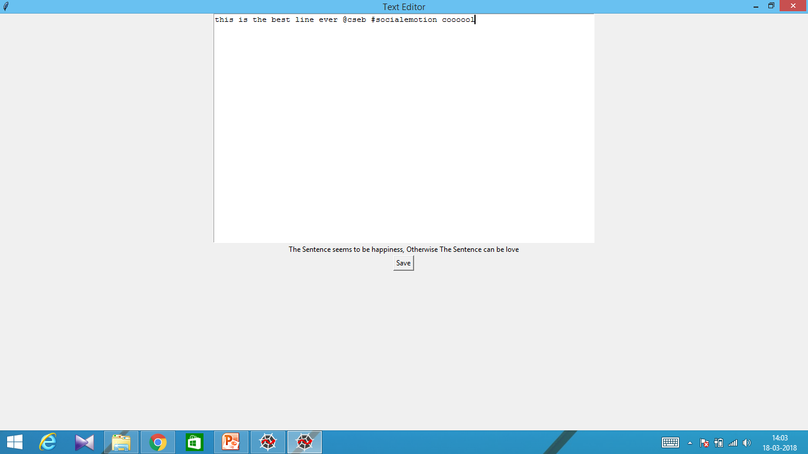
FRONT END: we integrated our backend python programming in spyder platform with both django as well as a normal text editor.

Slide 20
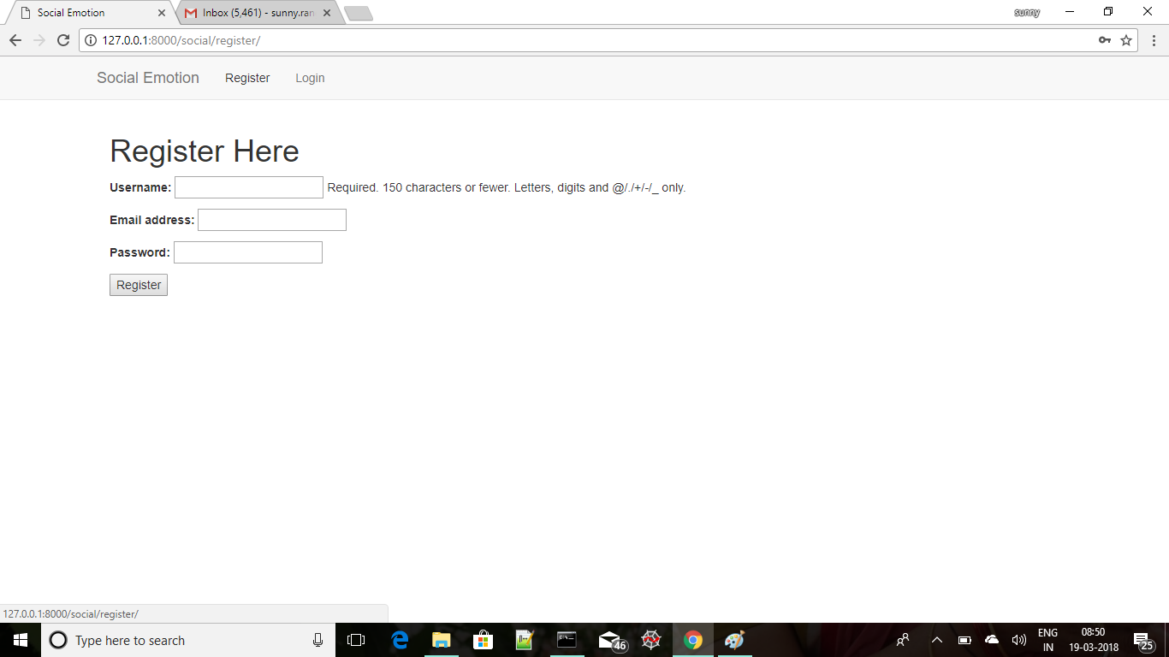

Slide 21
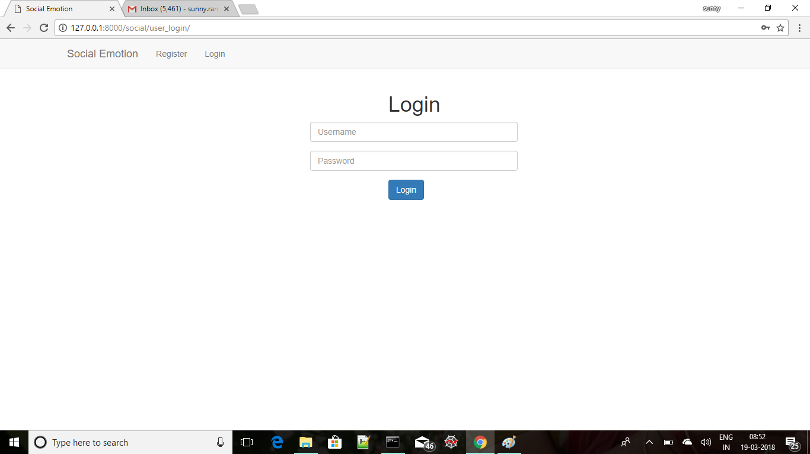

Slide 22
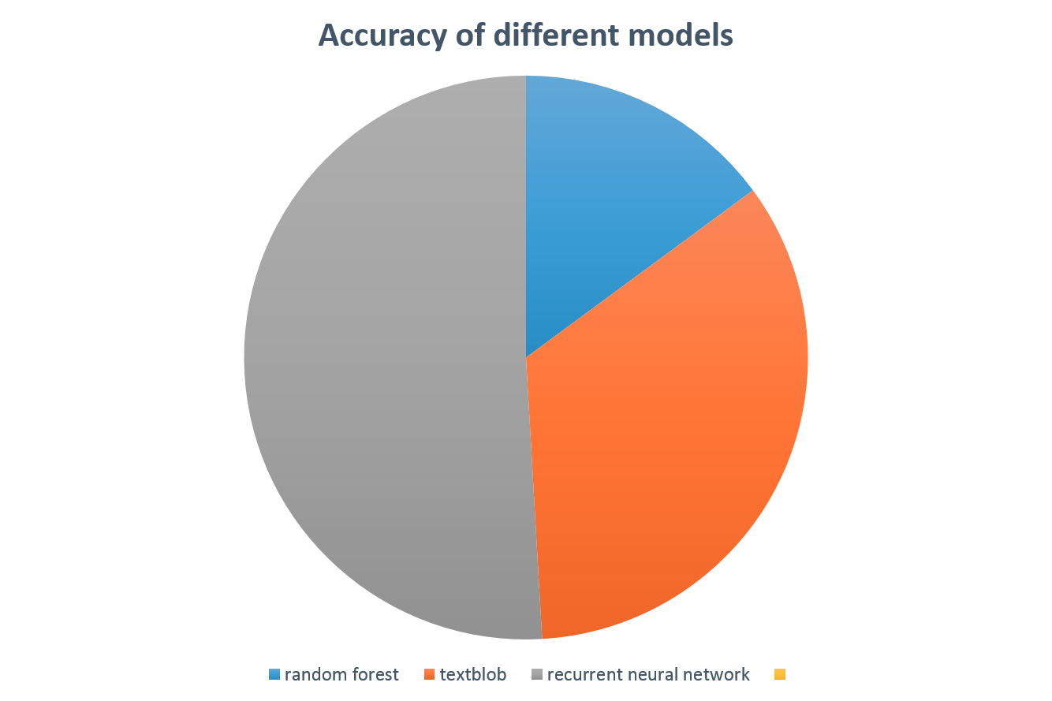

Slide 23
System Requirements
Language :Python
Tools:
Tensorflow & Theano – backend integrating interface for building neural networks.
NLTK- For text processing
Pandas- for data analysis and manipulation on tables
Numpy-support large set of arrays and manipulation in data cleaning.
Scikit learn: machine learning library for data classification.
Recurrent neural network is used for neural network building with lstm units to build a supervised learning model.
Django is used to create database driven website front end for our project.

Slide 24
Hardware:
Processor : 64 bit
Speed : 3.5 GHz
RAM : 4GB (min)
Hard Disk : 40 GB

Slide 25
Conclusion:
Successfully, develop a novel model of semantically rich hybrid neural network which are guided by supervised teaching models for emotion classification.

Slide 26
THANK YOU!

